Slide 1
CONTENTS
Abstract
​Introduction
​Literature Survey
​Proposed methodology
​Implementation & architecture
​Results & Discussion
​Conclusion & Future Scope​References​

Slide 2
ABSTRACT
This project proposes an automated irrigation system that intelligently manages water supply based on real-time soil moisture data .The system adjusts irrigation frequency and duration dynamically to optimize water usage and improve crop yields. Experimental results demonstrate its effectiveness in maintaining optimal soil moisture levels, contributing to sustainable agriculture practices. Using sensors and a microcontroller, the system monitors soil moisture and triggers irrigation when levels drop below a set threshold. By dynamically adjusting irrigation, the system optimizes water usage, leading to improved crop and water efficiency. This approach reduces manual irrigation effort, promotes water conservation, and ensures water is used only when necessary.

Slide 3
INTRODUCTION
Efficient water management in agricultural fields is crucial, and an automatic irrigation system based on soil moisture sensing has gained attention as a resourceful solution.
Effective irrigation management is crucial for sustainable agriculture, especially in regions prone to water scarcity.
The technology integrates sensors and controllers for precise irrigation management.
Automated systems can be tailored to different soil types and crop needs, promoting sustainable agriculture.

Slide 4
LITERATURE SURVEY
S.No. | Name of Author | Title of the paper | International journal/conference | Volume No. | Issue | ISBN/ ISSN | Indexing
1. | M. K. Patil, S. T. Patil | Soil Moisture Sensor Based Automatic Irrigation System | International Journal of Electronics Engineering Research.(IRJET) | 08 | 05, May 2019 | e-ISSN: 2278-0181 | 455-457
2. | R. Singh, A. Kumar | Automated Irrigation System Using Soil Moisture Sensors and GSM | International Journal of Recent Technology and Engineering(IJRTE) | 07 | 06, March 2019 | e-ISSN: 2277-3878 | 298-300
3. | A. Kumar, M. Singh | Smart Irrigation System Using IOT and Soil Moisture Sensors | International Journal of Engineering Research and Technology(IRJET) | 09 | 06, June 2020 | e-ISSN: 2278-0181 | 1450-1453

Slide 5
PROPOSED METHODOLOGY
The proposed methodology for automatic irrigation involves deploying soil moisture sensors to monitor moisture levels in real-time. Data from these sensors is processed by a microcontroller, which then triggers irrigation systems as needed to maintain optimal soil moisture. This ensures efficient water use and consistent soil conditions for plant growth.
The system can integrate weather forecasts and historical data to further refine irrigation schedules, promoting sustainable water management and reducing the risk of overwatering or underwatering.
The system can also be monitored and controlled remotely via a mobile app, providing users with convenience and flexibility in managing their irrigation systems.

Slide 6
Methodology involves:
Install Soil Moisture Sensor: Place sensor in the soil.
Set Thresholds: Decide ideal moisture levels.
Connect to Controller: Link sensor to an irrigation controller.
Program Controller: Configure it to read sensor data.
Decision Making: Controller activates irrigation if levels are low.
Adjustment: Periodically review and adjust settings.
Power Management: Ensure continuous power supply.
By implementing this methodology, you can efficiently manage irrigation and ensure that plants receive the right amount of water, leading to improved crop yields and water conservation.
Irrigation application efficiency is the ratio of the quantity of water stored into the root zone of the crops to the quantity of water delivered into the field .

Slide 7
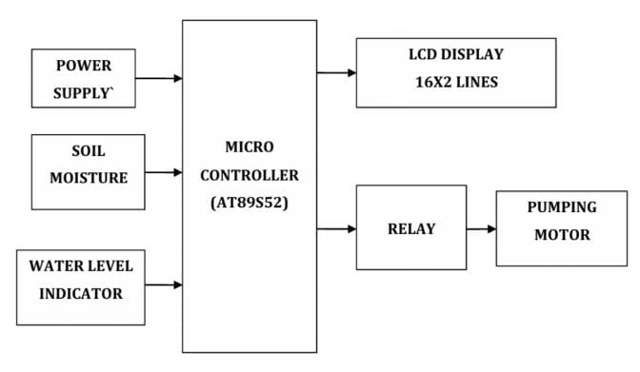
IMPLEMENTATION & ARCHITECTURE

Slide 8
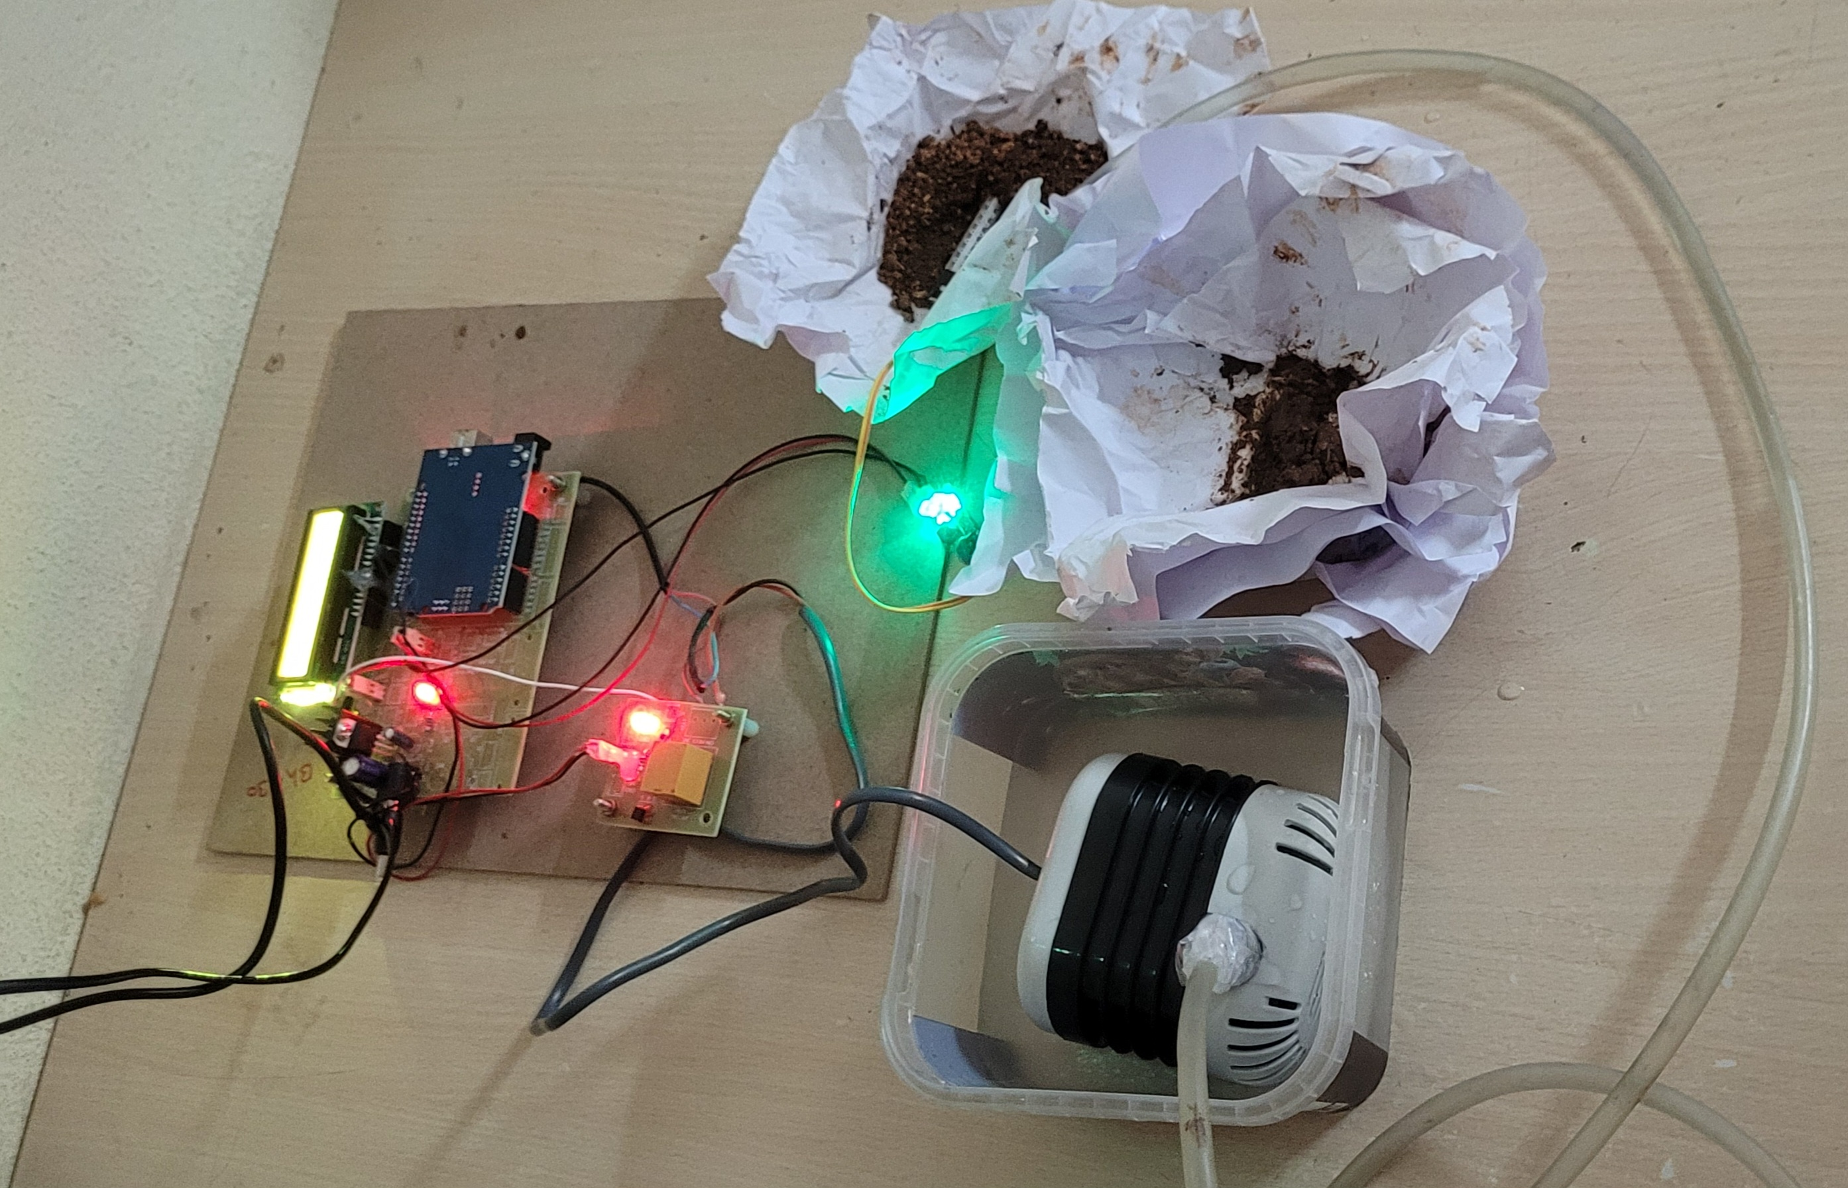
Testing and Output:
Dry conditions trigger the system to irrigate, increasing soil moisture content.
Conversely, wet conditions cause the system to stop irrigation, maintaining the soil moisture at optimal levels.

Slide 9
RESULTS & DISCUSSION
The automatic irrigation system was tested in bare soil with different threshold values of soil moisture. Three operational schedules were monitored for evaluation of the system. For each operational schedule, three irrigation events were monitored in the bare field condition.
The implementation of the automatic irrigation system showed significant improvements in water use efficiency and plant health. Soil moisture levels remained within the optimal range for the specific crops, resulting in better growth and yield.
By maintaining optimal soil moisture levels, the system supports healthier plant growth and higher yields.

Slide 10
CONCLUSION AND FUTURE SCOPE
The study concludes that the proposed automatic irrigation system effectively enhances water use efficiency and promotes healthier plant growth by maintaining optimal soil moisture levels. Significant water savings and improved crop yields were observed, demonstrating the system's potential for sustainable agricultural practices. Despite the initial setup costs, the long-term benefits in terms of water conservation and increased productivity make it a valuable investment. Further research should aim at reducing costs, improving scalability, and integrating advanced analytics to optimize the system further.

Slide 11
REFERENCES
Prashant J. Mahajan; Kalyani V. Pagare, “PIR based automatic fever testing”, International Research Journal of Engineering and Technology(IRJET),vol-07,issue no-04,pp.1345-1347,2020.
Pooja Ajmera, “INFRARED SENSOR” , International Research Journal of Engineering and Technology(IRJET), ISSN: 2278-0181 vol-05,issue no-23,1559-1557.
Hanzhong, “DESIGN OFA NON-CONTACT INFRARED THERMOMETER”, International Research Journal of Engineering and Technology(IRJET),ISSN: 2581-0181 vol-08,issue no-13,1859-183
Rohit Ramagade , Uday Thak, Harshad pidurkar , Lokesh Kathale; ”INNOVATIVE TECHNOLOGIES FOR TEMPERATURE MEASUREMENT OF AERO ENGINE COMPONENT”, International Research Journal of Engineering and Technology(IRJET), ISSN: 2395-0056 vol-05,issue no-23, 2395-0072
Akshay Sharma A S, “ Review on Automatic Sanitizer Dispensing Machine”, International Research Journal of Engineering and Technology(IRJET),vol-09,issue no-07,pp.725-726,2020.

Slide 12
THANK YOU

